Slide 1
PRINTABLES – The Printing Expert

Slide 2
PRESENTED BY -
NOEL JAIS (220021090000 )
JOEL JAIS (220021089991)
Project Guide: DR. ABHAYADEV. M

Slide 3
ABSTRACT
Efficient Order Management: Direct PDF uploads streamline order handling, eliminating email and WhatsApp inefficiencies.
Comprehensive Customization: Users can specify page quantity, print type, color preferences, binding choices, and paper size/material.
Real-Time Cost and Payments: Real-time cost calculation and secure online payments enhance transparency and convenience.
User-Friendly Interface: Easy account creation, file uploads, and notifications keep users updated on job progress.

Slide 4
INTRODUCTION
PRINTABLES The Printing Expert is a comprehensive solution designed to streamline and enhance the printing experience for users. This project encompasses a range of functionalities including user authentication, shop selection, print job customization, cost estimation, payment processing, notifications, job tracking, and additional services for custom products. The goal is to create an efficient, user-friendly platform that meets diverse printing needs with transparency and security. Efficiency and productivity are critical for success in today’s fast-paced corporate climate. The ongoing need for high-quality prints, enormous volumes, and short turnaround times can be daunting. Businesses, on the other hand, may streamline their printing process and gain higher efficiency with the correct solution.

Slide 5
IMPORTANCE
PRINTABLES - The Printing Expert provides a seamless solution for managing print jobs, catering to both businesses and individuals with a growing need for efficient and customizable printing services. Its relevance is highlighted by the increasing demand for convenient and reliable print solutions.
Key Strategies for Success:
Diversify Services: Expand beyond traditional products like business cards and flyers to include large-format printing, promotional items, and variable data printing. This broadens your customer base and boosts sales with items such as banners, mugs, and t-shirts.

Slide 6
CONTINUE..
Prioritize Customer Service: Deliver exceptional service by providing accurate quotes, quick order turnaround, and regular updates. Offering design services and a web-to-print storefront can enhance customer satisfaction.
Market and Advertise: Utilize digital marketing strategies like pay-per-click, social media, and email campaigns. Offline methods, such as print ads and networking events, are also effective for reaching new customers.
Continuously Improve Processes: Regularly assess and refine workflows, invest in new technology, and stay updated on industry trends to enhance efficiency and competitiveness.

Slide 7
BENEFITS
Streamlined Process: Simplifies the printing workflow from customization to payment.
User-Friendly: Easy-to-navigate interface for all skill levels.
Customization: Extensive options for tailoring print jobs.
Real-Time Cost Estimation: Transparent pricing before order confirmation.
Secure Transactions: Protects user data and payment information.

Slide 8
MERITS
Merits:
Streamlined Process: Makes ordering prints easier and faster.
User-Friendly: Easy to navigate and access for customers.
Direct Uploads: Customers can upload files directly.
Customization: Users can choose print options that fit their needs.
Real-Time Pricing: Shows costs instantly based on choices.
Secure Payments: Ensures safe transactions for users.
Order Updates: Keeps customers informed about their order status.

Slide 9
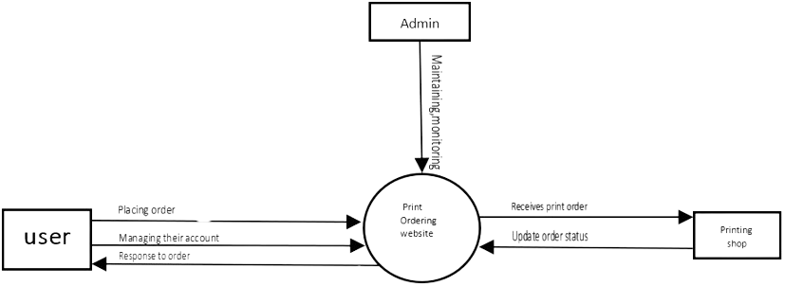
LEVEL O DATA FLOW DIGRAM

Slide 10
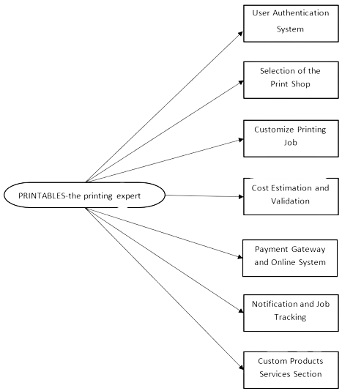
LEVEL 1 DATA FLOW DIGRAM

Slide 11
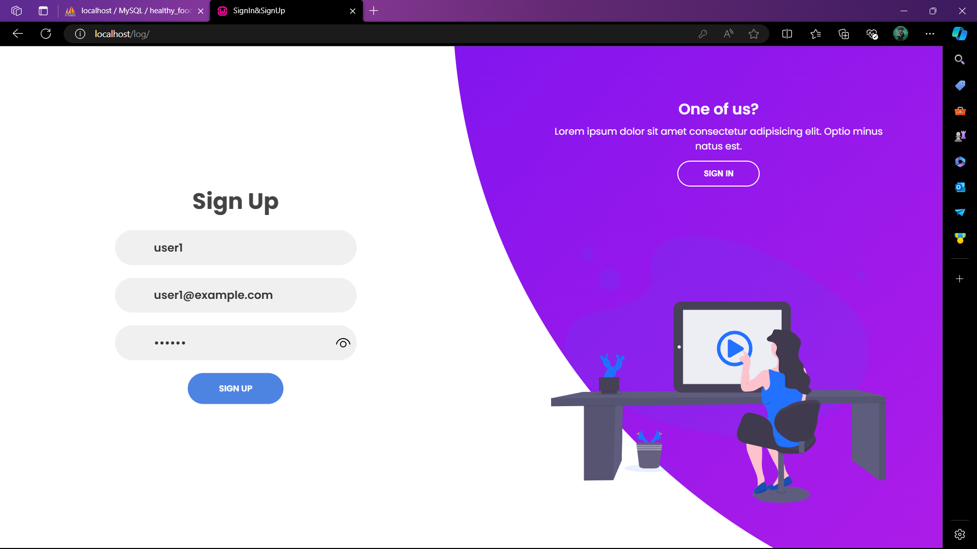
SCREENSHOTS
USER SIGN UP PAGE

Slide 12
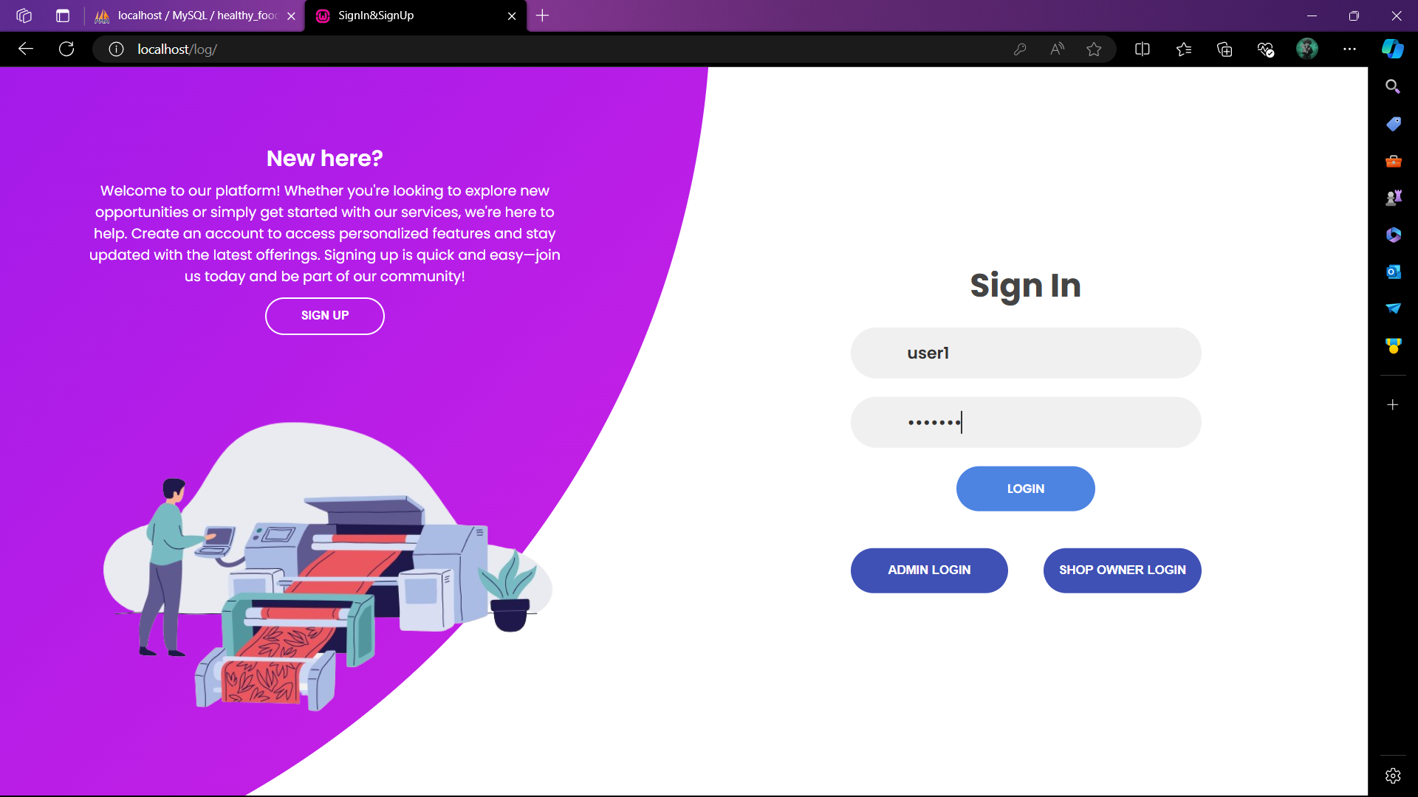
SCREENSHOTS
USER LOG IN PAGE

Slide 13
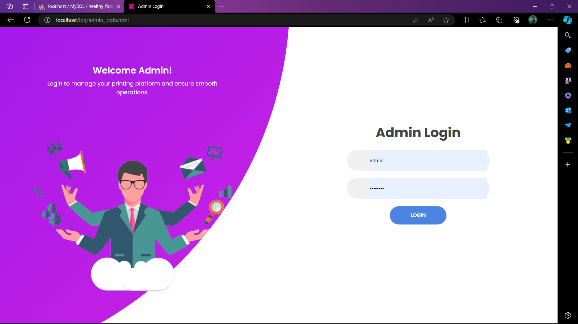
SCREENSHOTS
ADMIN LOG IN PAGE

Slide 14
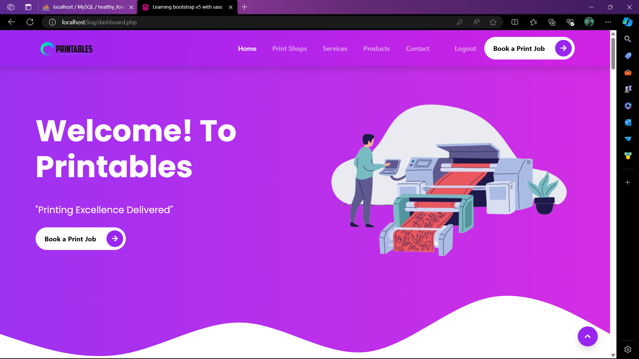
SCREENSHOTS
USER DASHBOARD LANDING PAGE

Slide 15
Thank you!

